Slide 1

Social Media Analytics for Smart Health
By:
Bhumireddy Ranjitha reddy- 04

Slide 2
INTRODUCTION
Growing emphasis on generating and accessing medical content via social media.
Many platforms like social media, virtual worlds and mobile applications are developed to generate new avenues in health care system.
Many groups in society like patients, physicians, hospitals, pharmaceutical companies and many agencies are tending towards the analysis to get which channels are best in providing exact information.
Meta-analysis of social warranties empirical insights like :
Credibility
Recency
Uniqueness
Frequency and Salience

Slide 3
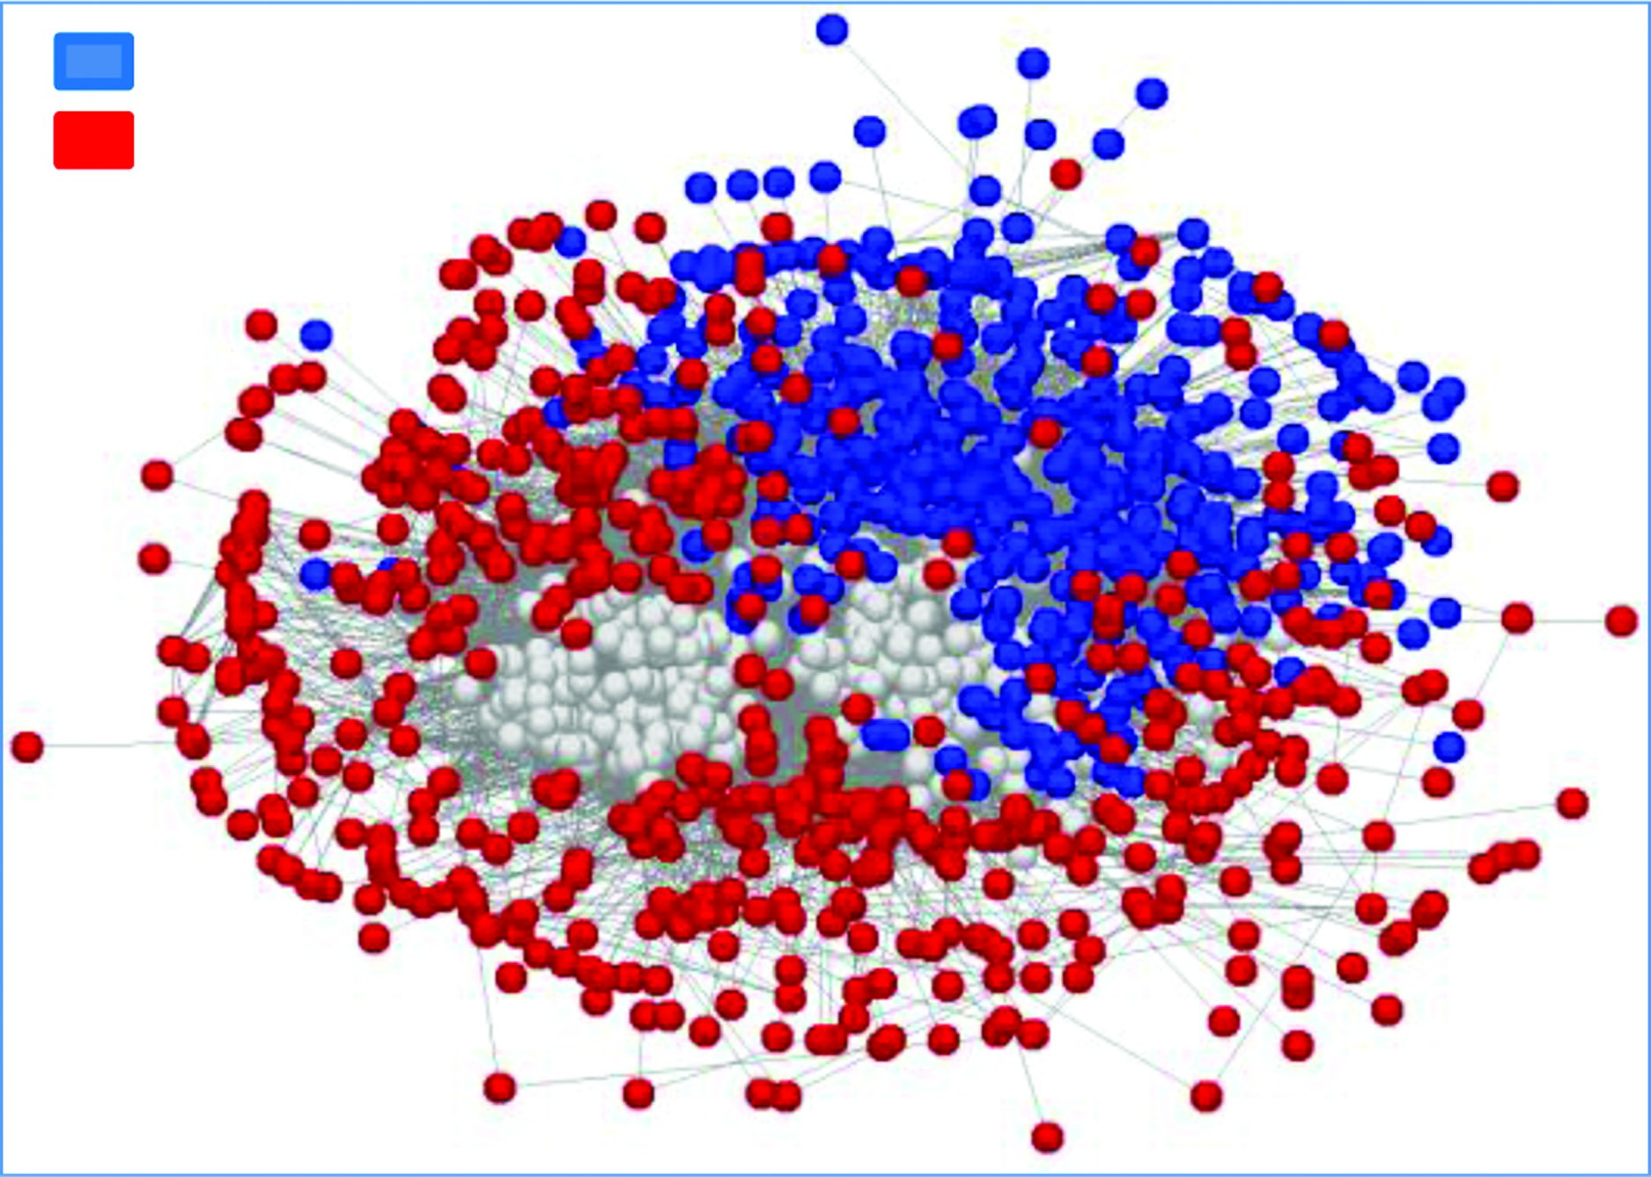
CREDIBILITY
This insight refers to the Quality, trustworthiness and integrity of information appearing in social media.
As the social media runs on user generated content , entire information like source and message are critical.
Studies were conducted to determine the levels of credibility, reviews in between 4 and 10 percent on four websites were spam.
In the same manner 10 percent of blogs were also examined as spam where as 40 percent of U.S and Biz domains are not credible.
The data for this assessment had taken from many third party URLs’ databases like LegitScript,NABP,Health on Net and The Consumer and Patient Health Information Section(CAPIS).
One important issue that we can see is all the credible content is closely connected and non-credible content is dispersed.
Need to investigate mmore on non-credible content.
Credible
Not credible

Slide 4
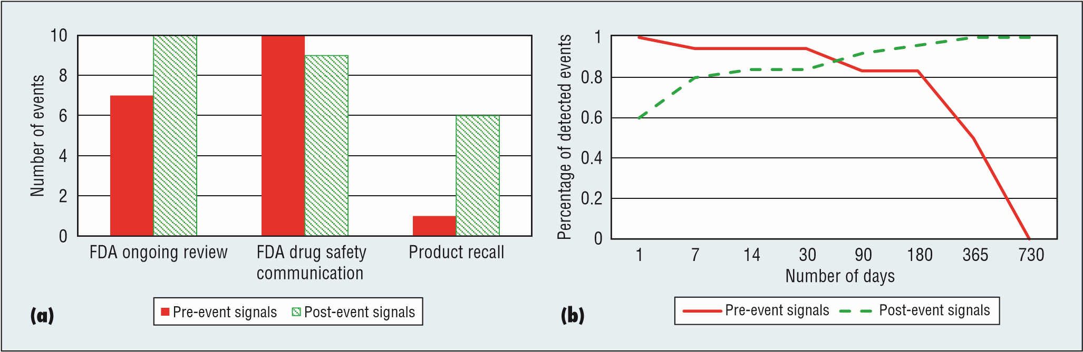
RECENCY
It refers to the timeliness of information and insights attained in recent social media, which acts as both early warning indicator and as a proxy.
Recency acts as a crowdsourcing where data can be taken and also introduce duplicity and redundancy.
Indexes can be varied according to time series like in political and financial views it is a lag indicator where as most recently it is considered as lead indicator.
Three types of events were examined in a preliminary work to know the relation between social media and 50 drug events. They are : Product Reviews, Ongoing calls and Drug safety communications.

Slide 5
UNIQUENESS
Channel uniqueness has more important implications for data integration and fusion.
The main intuition behind integration in the context of analytics can be epitomized by a saying “ The sum is greater than its parts”.
Integrating data from many channels boosts all the week patterns , however the line between compliment and duplicate becomes blurred.
This is the chart showing the adverse drug-reaction named Yasmin for the year 2009-2012.
(
a
)
(
b
)
(
c
)
(
d
)
(
f
)
800
700
600
(
e
)
500
400
z
-
score =
300
3
X
200
z
-
score =
2
100
0
1/2009
1/2009
1/2009
1/2010
1/2010
1/2010
1/2011
1/2011
1/2009
1/2011
1/2012
1/2009
1/2009
1/2009
1/2009
1/2009
1/2009
1/2009
1/2009
1/2010
1/2010
1/2010
1/2010
1/2010
1/2010
1/2010
1/2010
1/2010
1/2011
1/2011
1/2011
1/2011
1/2011
1/2011
1/2011
1/2011
1/2011
1/2012
1/2012
1/2012
1/2012
1/2012
1/2012
1/2012
1/2012
1/2012
/
/
/
/
/
/
/
/
/
/
/
/
/
/
/
/
/
/
/
/
/
/
/
/
/
/
/
/
/
/
/
/
/
/
/
/
/
/
/
/
/
/
/
/
/
1
/
2
3
4
5
6
7
8
9
1
2
3
4
5
6
7
8
9
1
2
3
4
5
6
7
8
9
1
2
3
4
5
6
7
8
10
9
11
12
10
11
12
10
11
12
10

Slide 6
FREQUENCY AND SALIENCE
Channel volumes vary significantly, millions of new tweets dauly, 5 millions of daily searches,no.of forum postings and blog entries also exceeds bimillion.
Conversely only thousands of articles , research abstracts and adverse event reports. Thus frequency and salience are inversely proportional.
Higher volume channels gets minimum number of twitter words which limits the salience.
Blogs and web forum postings can be lengthier by including sentiment, affect, knowledge and expectations.
Thus research is necessary to evaluate the dynamics and implicataions of channel frequency and salience as they related themselves to health analytics.

Slide 7
Natural Language Processing for Health and Social Media
By:
Vilas Mamidyala - 18

Slide 8
Natural Language Processing for Health and Social Media:
In recent years, social media has emerged in the health community, particularly in public health, as a revolutionary data source for a wide range of problems.
Social Media provides large amount of data as well as quick data at lower cost which is still difficult to utilize.
The structure must be inferred from unstructured data, but automated methods are only viable at scale
Methods based on natural language processing (NLP), an area of computer science focused on developing algorithms to understand human language, can handle these limitations by making use of richer context.
NLP helps in discovering health issues in social media messages, or trends in sentiment about physicians in doctor reviews.
Notes:
How many messages about flu infection on each day?

Slide 9
Discovering Health Issues
Health issues are discovered from the commonly discussed social media using topic models, a class of NLP tools that can be used to organize large volumes of text.
With minimal human intervention, topic models can automatically discover prominent themes (“topics”) in text without specific knowledge of the dataset.
For Twitter data, we created the Ailment Topic Aspect Model (ATAM), a specialized topic model that explicitly distinguishes health topics from other topics by incorporating general knowledge of symptoms and treatments as extracted from a health website
Ailments as a resource for public health information by measuring their ability to capture real-world trends of health lifestyle factors as measured by the US Behavioral Risk Factor Surveillance System (BRFSS), a large annual survey of American adults.
Notes:
The Topic Modeling Toolbox (TMT) features that ability to: Import and manipulate text from cells in Excel and other spreadsheets., Train topic models (LDA and Labeled LDA) to create summaries of the text. Select parameters (such as the number of topics) via a data-driven process. Generate rich Excel-compatible outputs for tracking word usage across topics, time, and other groupings of data.
When ATAM was applied to a large health Twitter collection—1.6 million health related tweets from 2009–2010—it discovered 15 health topics or ailments, including allergies, aches and pains, dental health, and insomnia.

Slide 10
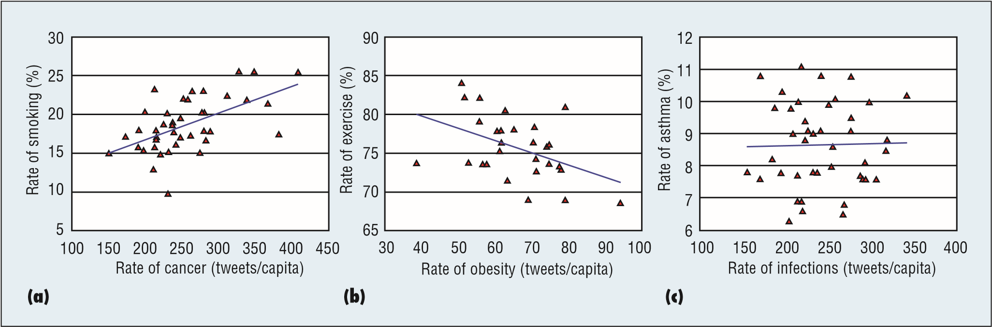
Scatterplots of the volume of tweets per US state for various ailments which are (a) positively, (b) negatively, and (c) not correlated with government survey data.
This NLP-driven analysis highlights health areas that are supported by the data, leading to new directions of study.

Slide 11
Deeper Linguistic Analysis for Influenza Surveillance
ATAM exploration was focused only on words but not on Rich linguistics.
For the task of influenza tracking, which requires algorithms that determine the intention of each tweet, we utilized supervised machine learning with rich features for deeper language analysis to make subtle distinctions in the texts.
To obtain more accurate influenza measures, we trained supervised classifiers on more than 10,000 tweets labeled by humans to determine if a specific tweet reported an influenza infection.
These subtle distinctions in language required the construction of a rich set of linguistic features, including
• longer phrases (n-grams);
• human-created groups of keywords (for example, concern-related words such as “worried” and “scared”);
• Twitter-related features such as URLs, hashtags, user mentions and emoticons
• linguistic features using part-of speech (for instance, noun or adjective) information associated with each word.

Slide 12
CDC
Twitter
Influenza rate
Dec 2011
Apr 2012
Aug 2012
Jan 2013
May 2013
Our Twitter-derived estimate of influenza prevalence in the U.S. over time, along with the rate measured by the US Centers for Disease Control and Prevention (CDC). The two trends have a correlation of 0.85.

Slide 13
Beyond Twitter
Many health-focused online communities provide more detailed health information than twitter and require NLP algorithms to analyze the data.
RateMDs:
Used topic models of NLP for sentiment analysis on the reviews provided by the site. It is inferred that sentiment expressed is useful for analyze patient perceptions of healthcare across the US.
Drugs Forum:
Provides anonymous disused forum data about the illicit drug activity. Our summarization system correctly identified the typical dose and common side effects of mephedrone, a new and potentially dangerous drug.
Critically, at the core of social media is human language, and NLP technologies are required to mine these data.
An effective NLP approach begins by choosing the right data source—a site like Twitter for general monitoring of population health effects versus online forums for specialized medical questions—and continues with a clear formulation of the health question informed by domain expertise.

Slide 14
Social Media versus Privacy and Credibility
Predictive Algorithms for Patient Risk: Privacy versus Better Care:
Algorithms that predict out-of-hospital events such as readmission are not constrained by computing power, cost or complexity but by their reliance on electronic health record (EHR) data.
This unstructured data of EHR are unlikely to have much usable psychosocial, psychometric, or ecological data.
Despite sophisticated data mining, even IBM’s Watson is still working to extract new insights from EHR data beyond, say, distended neck veins predicting readmission for congestive heart failure.
Sources of data could be low tech. Hospital staff could simply ask patients or relatives etc. This is a costly and slow approach.
Using offline data from public records, surveys, and questionnaires, loyalty cards, brick-and-mortar shopping behaviors, and data aggregators have some of the data missing from current predictive algorithms. This is high tech data.
Precisely such combined social and offline data could give insights into patient behaviors and social determinants of health that critically impact some types of clinical risk.

Slide 15
Anti-vaccination Campaigns: Diversity of Opinion versus Deception and Manipulation
It is well known that social networks of interconnected individuals have mediating effects on health. Some of these effects are positive and some are negative based on how we treat health issues.
The users who are skeptical about vaccines clearly have the desire and right to share information, create content for others to consume, and to belong to a freely sharing network of individuals.
Although the Twitter disclosures are related to traditional childhood vaccinations, a more novel vaccination has been for human papillomavirus (HPV) infections.
The medical and regulatory consensus is that generally no significant harms are caused by the vaccine. It could be argued that Tweets and blog posts are public disclosures, and so vaccine skeptics contribute to the diversity of opinions found on social media.
New sources of data such as social media can quickly entail threats to privacy and free speech and may also deliberately contain harmful, wrong information.
Society-wide discussion of the tradeoffs between patient privacy and caring better for patients, or consumer diversity of opinion and enhancing the credibility of social media data is crucial.

Slide 16
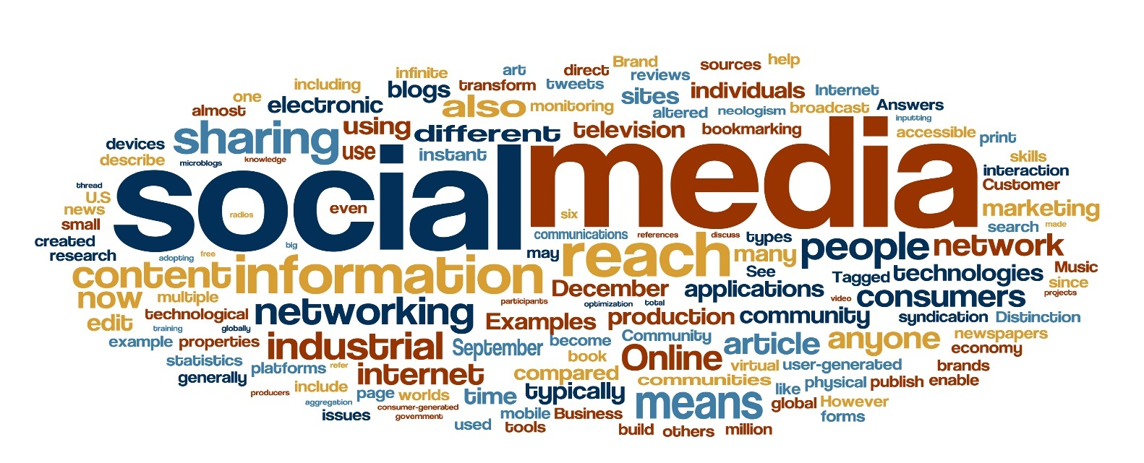
Any Questions ☺

Slide 17

Treating Patients’ Real Avatars in the Virtual Medical Office
Vikesh Padarthi

Slide 18
Introduction :
According to the US Center of Medicare and Medicaid Service data, healthcare cost in the US has been rising exponentially in the last three decades and is far above any other developed country, yet yielding much lower health outcomes.
As part of this project, second life of patient called Avatar is developed and used for the delivery of medical services.
Wearable and other bio sensors are used to create avatars that have real-time vital data.
These bio sensors are helpful to carry patients vital data in real time.
Experiments with avatars of volunteer patients with gastrointestinal (GI) diseases visiting the avatar of a real physician show the tremendous potential of this approach in delivering medical care.

Slide 19
Project Overview :
The objective of this project is to develop an innovative way of providing medical care that accomplishes two seemingly conflicting objectives simultaneously: increasing access to medical care while reducing medical costs.
Proposed approach is to use virtual medical offices in 3D virtual worlds, enabling interactions of patients and physicians’ avatars. The novelty of our approach is in the creation of “real avatars” that carry patients vital data, which are accessible to authorized physicians only.
Three inter-related theories— telepresence, social presence, and flow have been applied in the investigation of virtual worlds. We relied on these three theories to illuminate the advantage of virtual worlds for creating technology-mediated access to medical office visits.

Slide 20
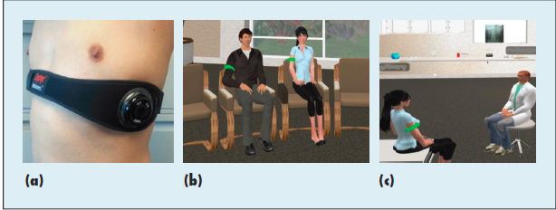
3D Virtual world

Slide 21
Continued…
Group office visits are particularly suitable in virtual medical offices, because patients participate in the visits anonymously through their avatars.
In face-to face group office visits, patient privacy is an issue.
A virtual office visit eliminates the privacy issue, since individuals remain anonymous to other group members.
At any time during the virtual medical office visit, the physician can click on the armband of a patient avatar to check that patient’s vitals or visit a Web portal, which shows all of the patient avatars’ vitals.

Slide 22
Experimental Results:
During a virtual medical office visit, each patient wears a wearable bio sensor, which captures the patient’s vitals in real time. Other sensors are also used to capture additional physiological data, such as blood oxygen and weight. The sensor data are first transmitted via Bluetooth to either a Smartphone or a tablet, then forwarded to a Web portal and finally loaded to the patient’s avatar.
Study was carried out in two stages
In the first stage, the technology was developed and tested. We elected Zephyr BioHarness (www.zephyranywhere.com), which is a wearable bio sensor that has its own mobile apps.
The second stage involves testing patients acceptance of virtual medical office visits through an experiment with volunteer patients and a volunteer physician.

Slide 23
Continued…
An overall average rating of 8.9 on a 0–10 scale, with 10 being the highest.
Satisfaction with the physician was also high with an overall average of 8.6.
Sensors were deemed trustworthy with an overall average of 9.2. satisfaction with the group experience had an overall average of 8.1.
In terms of comparison with face-to face physician office visits, the patients rated the similarity of their experience with face-to-face office visits at 8.0 on a 0–10 scale.

Slide 24
Advantages
Creating “real” avatars makes virtual medical office visits more efficient and informative.
Since the vital data is captured in real time, the physician has more up-to-date health data than in traditional office visits.
Virtual medical offices require only a small fraction of the cost relative to building and maintaining brick-and mortar medical offices, and could offer 24/7 medical services regardless of the patients’ and physicians’ geographical location.
Two goals that can be achieved are substantially decreasing the cost of medical services and increasing accessibility to medical care.

Slide 25
Challenges
Including patient and physician education in the use of the technology.
Protecting patient health records from hackers.
Appropriate use of the technology to preserve quality of care.

Slide 26
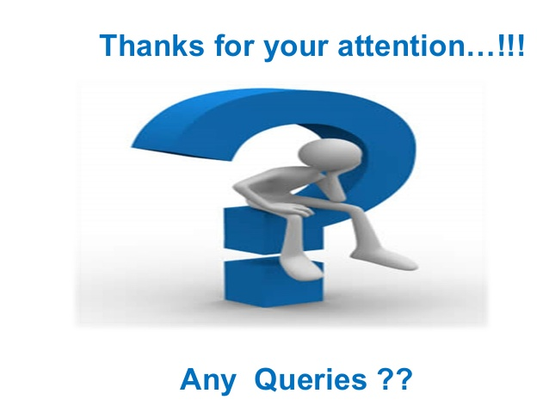

Slide 27
Signal Fusion for Social Media Analysis of Adverse Drug Events
Dinesh Kumar BANDAM (02)

Slide 28
Introduction:
Rapid detection of adverse reactions to a drug is essential in limiting the potential harm to patients taking the drug. Detecting adverse drug reactions (ADRs) is an evolving science .
we attempt to analyze to exploit online data sources and predict these reactions.
The key motivation for studying drug adverse events using social media data is the recent success in the use of online search query logs in reliably predicting the outbreak of influenza.
White and his colleagues used software to track drug symptoms as user enter in online search query in order to analyze drug reaction and since data is heterogeneous it is difficult to analyze reactions. This is generally social fusion.
Personal views about drugs are expressed in social media and raw text could change from structured to unstructured.Key issue is the design of fusion mechanism to derive a final decision after rendering many evidences.

Slide 29
Challenges in Signal Fusion for Social Media Analysis of Drug Events
The core challenges in signal fusion is very nature of social media data, and problem of analyzing and detecting drug reactions from such sources.
Diversity of signal source: The diverse nature of social media and significant differences in the nature and type of signals generated from each source, and differences in their reliability. Hence, we require methods to appropriately weigh the importance of each signal.
Temporal Resolution: some sources offer better local temporal information, others offer better global temporal information. Yet, other sources may require variable temporal resolutions for their analysis. Determining which resolution works best for a given source is a difficult task, which is further compounded when multiple sources are being considered

Slide 30
Signal Normalization: The signal values across individual sources may vary significantly. Clearly, combining information from such sources requires normalizing the individual signals prior to signal fusion.
Noise and Signal Extraction: Even after normalization some source exhibit relative lower S/N than other. The noise depends on the data and methods used to extract data and the search query has higher s/n ratio when compared to twitter data because of problems of redundancy and spamming
Signal Generation:
we used ADR model for signal generation based on the list of keywords like human anatomy, drug reaction and administrative problem.
signals are generated with search queries over the web signals and generated signals for each of 46 drugs. The twitter data is collected by using Topsy and collected data for all the 46 events prior to 2008 and collected data contained spam and most of it is removed by using rule based filter

Slide 31
To identify potential ADR mentions, lexicons were developed for anatomy related terms, reactions, and drug administration keywords. The lexicons, which were developed by research assistants with backgrounds in biology and medicine, were used to tag the tweets. For example, the tweet “Pradaxa caused me to experience severe internal bleeding!” would be tagged as “<DRUG>caused me to experience sever<ANATOMY><REACTION>”
Performance Analysis:
The performance of social fusion and its importance.
Datasets: We collected data on all drugs that had an FDA drug alert for adverse drug events, between January and September 2012. There were 67 such events and were concerned with drug and ADR related issues. The resulting dataset contained 46 individual drugs in 22 drug groups. For each drug group, there exists a single FDA webpage describing the problems. We manually analyzed the FDA website identifying the important points in terms of anatomy and reaction keywords.

Slide 32
Performance Metrics: We collected social media data about the FDA drugs from 2008 to 2012. We considered the anatomy and reaction keywords detected by the system and compared them with the keywords in the reference FDA webpages. We measure performance using the information retrieval metrics of precision and recall. Similarly, we compute the precision and recall when the anatomy and reaction keywords are used jointly. Pairwise combination of all the reaction keywords and anatomy keywords from each temporal period in the top k result. Any pair that appeared in the FDA reference webpage is taken to be a correctly detected pair.

Slide 33
Conclusion:
We have discussed various issues involved in fusing social media signals, when the objective is to detect and monitor possible adverse drug events. We proposed a method to fuse multiple signals from different social media channels. Initial results are quite promising, with some adverse drug events detected years before FDA alerts
The results show that social media data informally provided by millions of users could provide another important source of data for drug safety studies. We are just at the beginning stages of this unconventional approach to drug surveillance. However, various challenges— such as the diversity of social media sources, noise, data redundancy, and correlation between sources—must be further considered for improved performance

